Slide 1

EMPLOYEE MANAGEMENT SYSTEM

Slide 2
About me
Myself Saideepu Balaraju
I completed My B.Tech in the Stream Of Computer Science and Engineering from CVRT 2025.
Linkedin:linkedin.com/in/saideepu-balaraju
Github:https://github.com/SAIDEEPUBALARAJU-2003

Slide 3
Agenda (This should be the PPT flow)
Objective of the Project
ER Diagram
Key analysis questions (use cases)
SQL query results with screenshots
Final business insights
Conclusion
Challenges

Slide 4
Objective of the project
The objective of this project is to design and implement an Employee Management System that efficiently stores and manages employee-related data within an organization.
The system needs to track various aspects of employee information, including personal details, job roles, salary structures, qualifications, leave records, and payroll data. The system should ensure the integrity and consistency of data by using relational tables with appropriate foreign keys and cascading actions.
The system should allow for easy management and querying of employee data, providing insights such as payroll calculation, leave tracking, and department-specific job roles. The goal is to streamline HR operations, ensuring that all relevant employee data is accessible and accurately updated across different modules.

Slide 5
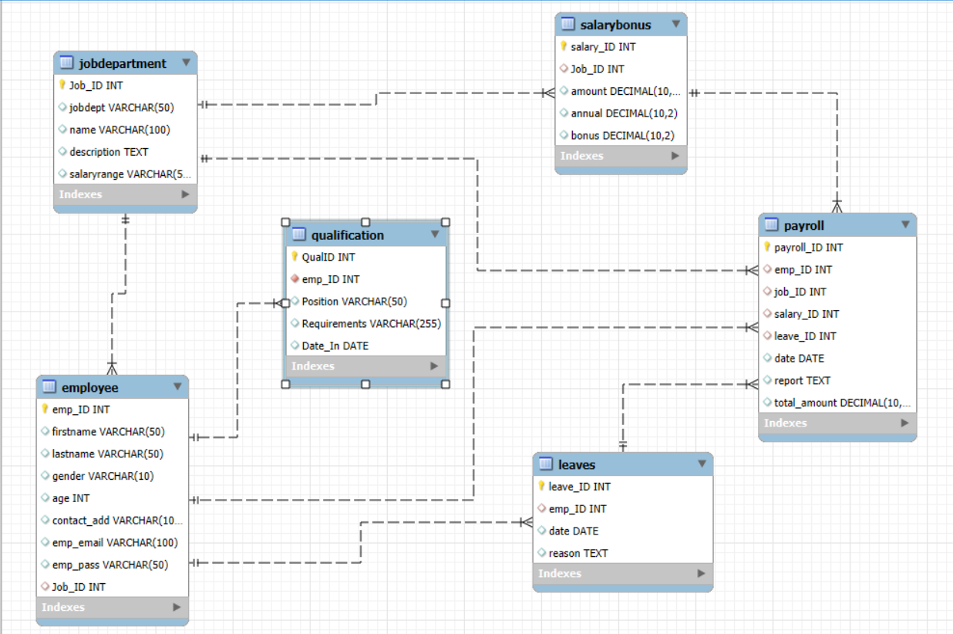
ER DIAGRAM

Slide 6
Key analysis questions
1. EMPLOYEE INSIGHTS
How many unique employees are currently in the system?
Which departments have the highest number of employees?
What is the average salary per department?
Who are the top 5 highest-paid employees?
What is the total salary expenditure across the company?
2. JOB ROLE AND DEPARTMENT ANALYSIS
How many different job roles exist in each department?
Which job roles offer the highest salary?
Which departments have the highest total salary allocation?

Slide 7
3. QUALIFICATION AND SKILLS ANALYSIS
How many employees have at least one qualification listed?
Which positions require the most qualifications?
4. LEAVE AND ABSENCE PATTERNS
Which year had the most employees taking leaves?
Which employees have taken the most leaves?
What is the total number of leave days taken company-wide?

Slide 8
5. PAYROLL AND COMPENSATION ANALYSIS
What is the total monthly payroll processed?
What is the average bonus given per department?
Which department receives the highest total bonuses?
What is the average value of total_amount after considering leave deductions?
6. EMPLOYEE PERFORMANCE AND GROWTH
Which year had the highest number of employee promotions?

Slide 9
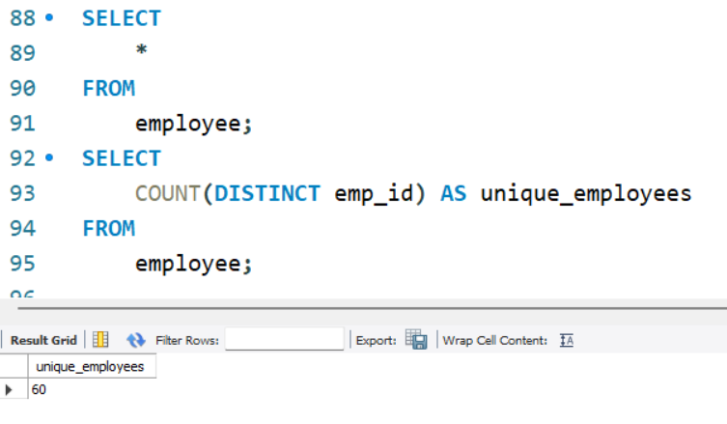
EMPLOYEE INSIGHTS
How many unique employees are currently in the system?

Slide 10
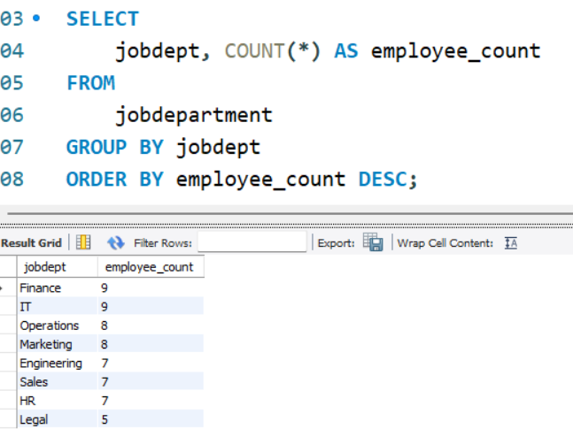
Which departments have the highest number of employees?

Slide 11
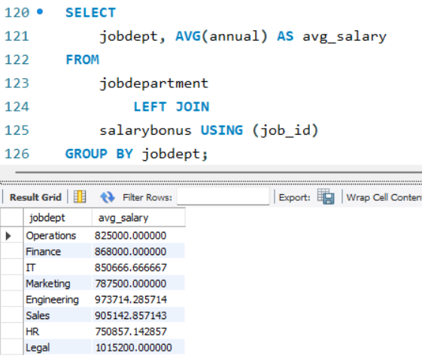
What is the average salary per department?

Slide 12
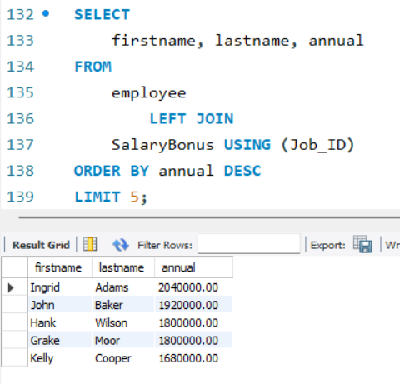
Who are the top 5 highest-paid employees?

Slide 13
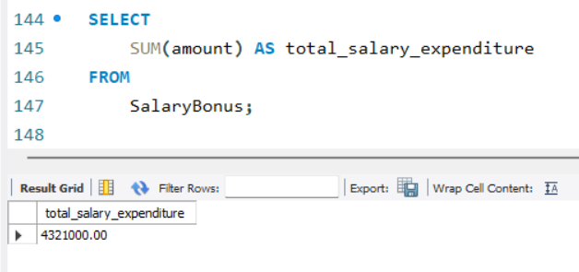
What is the total salary expenditure across the company?

Slide 14
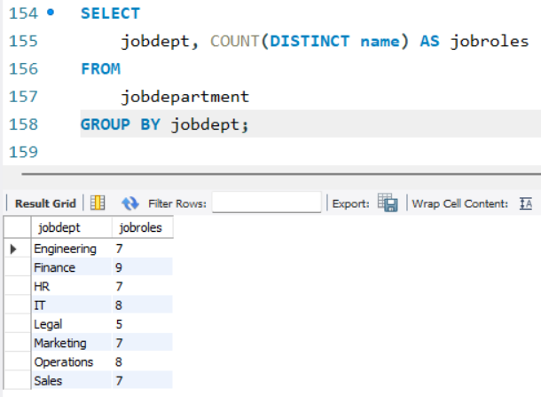
JOB ROLE AND DEPARTMENT ANALYSIS
How many different job roles exist in each department?

Slide 15
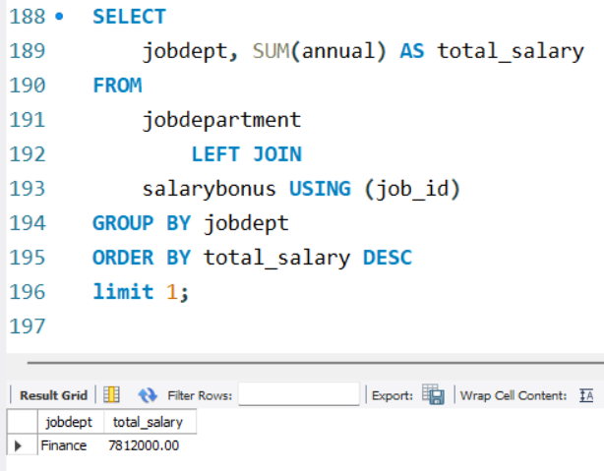
Which departments have the highest total salary allocation?

Slide 16
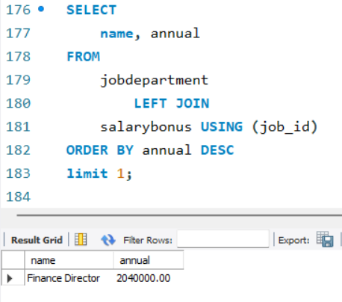
Which job roles offer the highest salary?

Slide 17
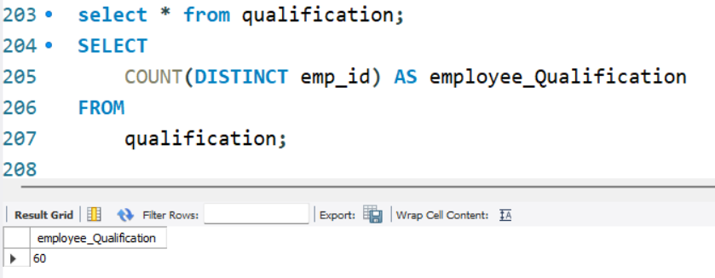
QUALIFICATION AND SKILLS ANALYSIS
How many employees have at least one qualification listed?

Slide 18
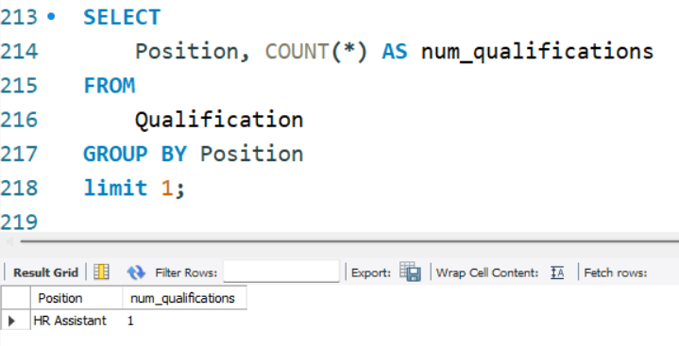
Which positions require the most qualifications?

Slide 19
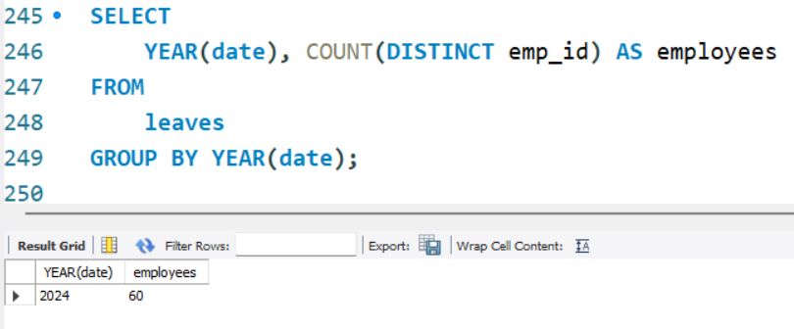
LEAVE AND ABSENCE PATTERNS
Which year had the most employees taking leaves?

Slide 20
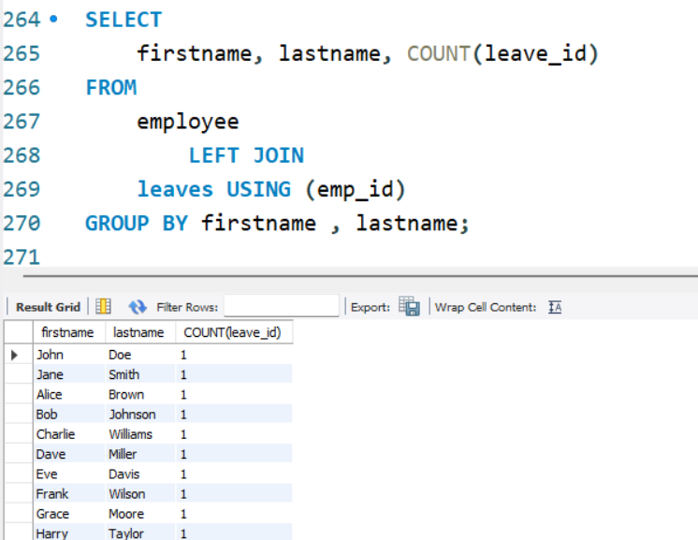
Which employees have taken the most leaves?

Slide 21
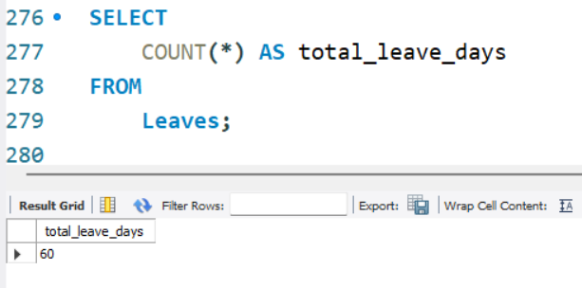
What is the total number of leave days taken company-wide?

Slide 22
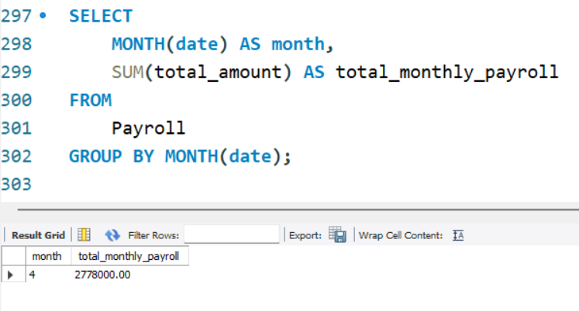
PAYROLL AND COMPENSATION ANALYSIS
What is the total monthly payroll processed?

Slide 23
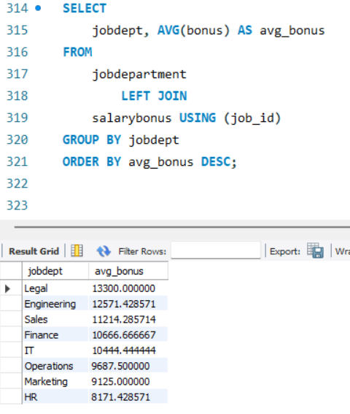
What is the average bonus given per department?

Slide 24
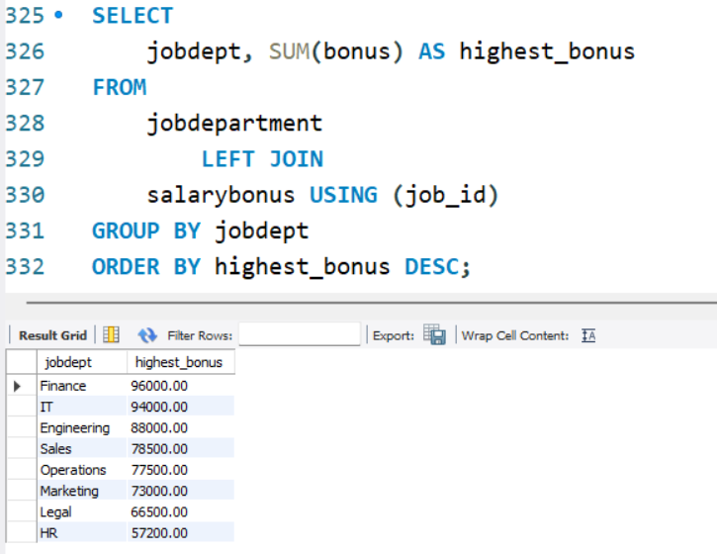
Which department receives the highest total bonuses?

Slide 25
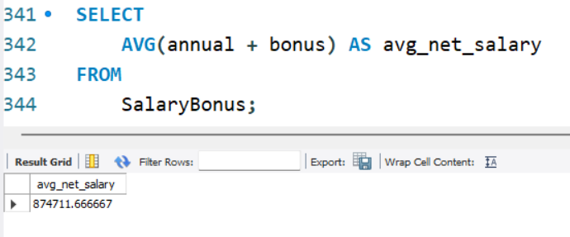
What is the average value of total_amount after considering leave deductions?

Slide 26
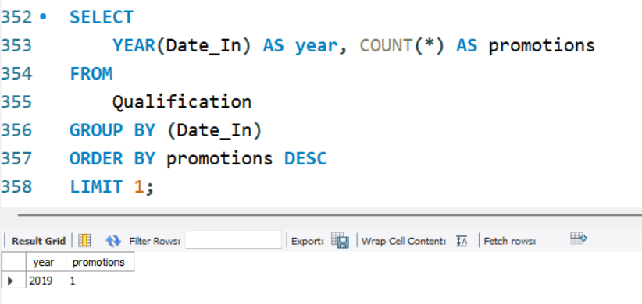
EMPLOYEE PERFORMANCE AND GROWTH
Which year had the highest number of employee promotions?

Slide 27
Final business insights
1. Employee Insights
The system effectively tracks 60 unique employees and their distribution across departments.
Finance department have a significantly higher number of employees.
Average salary varies by department, highlighting compensation strategy differences.
Top 5 highest-paid employees reflect senior leadership or highly skilled roles.
The total salary expenditure across the company is 432100.
2. Job Role & Department Analysis
Departments host multiple distinct job roles, suggesting diverse functions and operational structures.
Finance director job role are associated with higher salaries, likely due to skill demand or leadership position.
Finance Department with the highest salary allocation are either revenue-generating or require specialized expertise.

Slide 28
3. Qualification and Skills Analysis
60 number of employees have at least one qualification, showing a well-trained workforce.
HR position demand more qualifications, reflecting technical or compliance-heavy roles.
4. Leave and Absence Patterns
In 2024, a higher number of employees took leaves, possibly due to internal changes or external events (e.g., policy updates, pandemics).
The total number of leaves taken company-wide was 60.
A few employees have taken more leaves than the average.

Slide 29
5.Payroll and Compensation Analysis
Bonus distribution differs across departments, often based on performance or incentive structures.
Finance Departments receives highest bonus.
The average total payroll value is 847411(after leave adjustments) .
6. Employee Performance and Growth
The year 2019 having the most employee promotions provides insight into internal mobility and growth opportunities.

Slide 30
Conclusion
There are 60 unique employees in the system.
Finance department have the highest number of employees.
The highest paid employee is Ingrid Adams.
The Total Salary Expenditure Across The Company Is 4321000.
8 Different Job Roles Exist In Each Department.
Finance Director Role Offer High Salary Around 204000.
Finance Department Have The Highest Salary Allocation Around 204000.
60 Employees Are Having Atleast One Qualification.
HR Position Requires Most Qualifications.
Most Of The Employees Are Taken Leaves In 2024.
The Total Monthly Payroll Is Around 2778000.

Slide 31
Finance Department Receives Highest Bonus of 96000.
The Average Net Salary After Considering Leave Deductions Is 874711.
In 2019 Employees Had Highest Number Of Promotions.

Slide 32

THANK YOU

